Slide 1

Tracing Locations Through Words and Images: Investigating Large Language Model Reasoning in Geo-Localization
Bachelor’s Thesis in Informatics
Technische Universität München
TUM School of CIT
Author: Yujiaxuan Wang
Examiner: Prof. Dr. Chunyang Chen
Supervisor: Dr. Mark Huasong Meng
October 7, 2025 in Munich

Slide 2


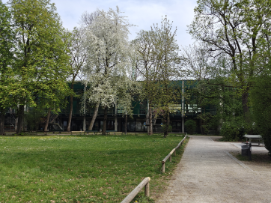
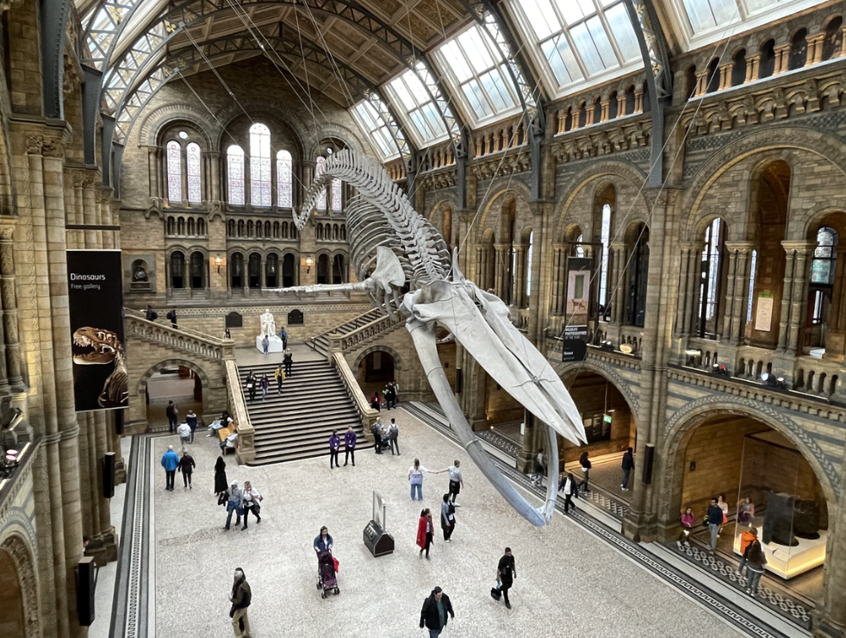
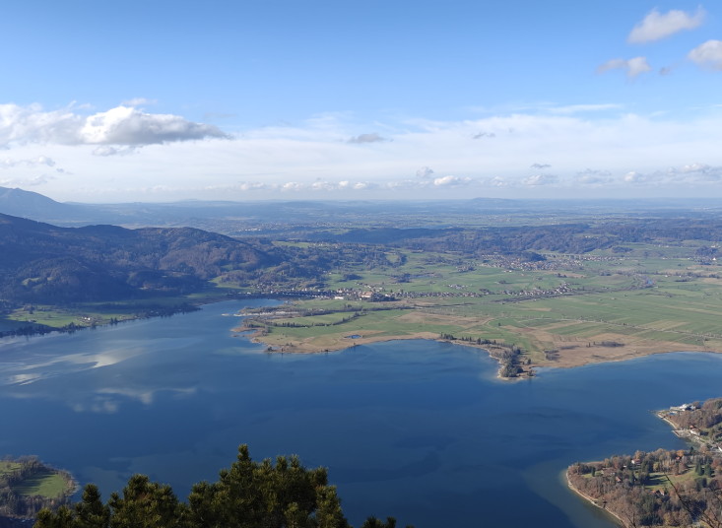
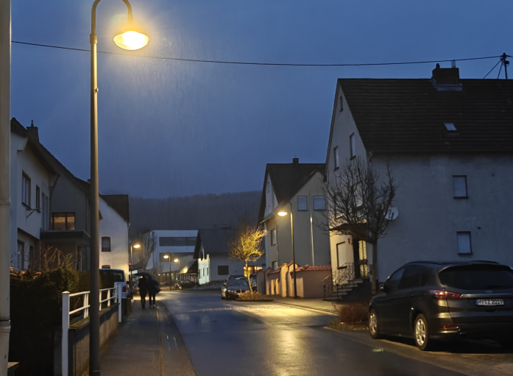
Motivation
LLMs show strong reasoning abilities
But: reasoning process remains a black box
Multi-modal reasoning: more opaque
Need interpretability
Through the lens of geo-localization: „ Where is this photo taken? “
Ideal test case
Complex: requires multi-step reasoning
Reasoning follows structure
Model: The street lamps seem German, and it's lightly raining.
…
I conclude with Weststadt, Herzberg am Harz, Lower Saxony, Germany

Slide 3
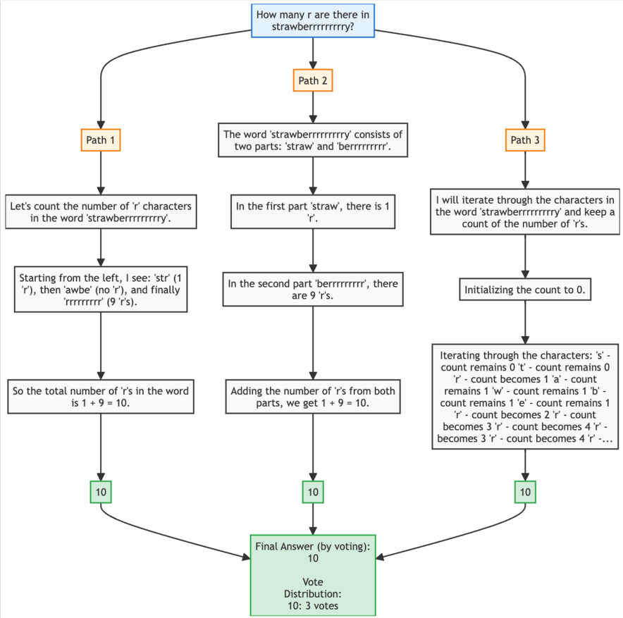
Research Gaps
LLMs Reasoning
Prior studies: mainly on textual reasoning (math, logic) [5]
Reasoning Visualization
Existing frameworks: paragraph-level and coarse-grained [1,2,4]
Geo-Localization with LLMs
Focus on accuracy or overall reasoning quality [6,7]
Gap: No framework for fine-grained, dynamic visualization of multi-modal reasoning (geo-localization)
Figure: Example of ReasonGraph [1]

Slide 4
Objective
This study aims to investigate the multi-modal reasoning process through the lens of image-based geo-localization

Slide 5
Study Design
RQ1: How capable are SoTA LLMs in geo-localization?
Built an image dataset and benchmarked three models
RQ2: Can we visualize their reasoning process?
Proposed a visualization framework GeoMindMap
RQ3: Can we recognize reasoning features?
Identified and analyzed five reasoning features

Slide 6
Approach Overview
Image
RQ1:
Benchmark
LLM
Output
Reasoning Tokens (Reasoning Summary)
+ Output Tokens (Output Text)
RQ2: Visualization
Prompt
“Your task is to deduce the specific location …
Let’s think step by step”
RQ3:
Features Analysis

Slide 7
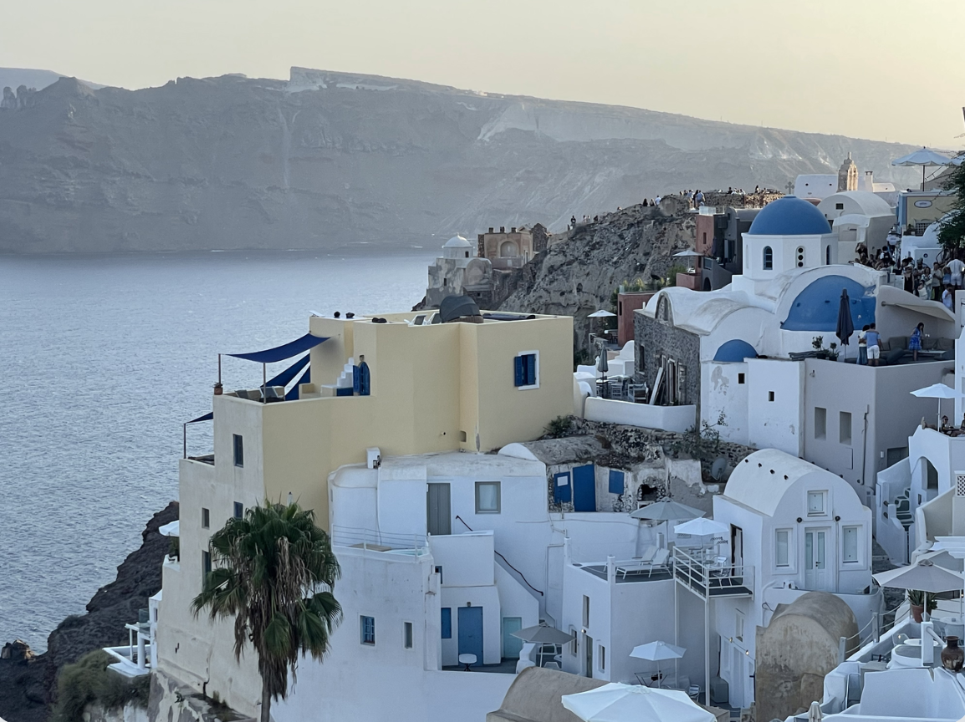
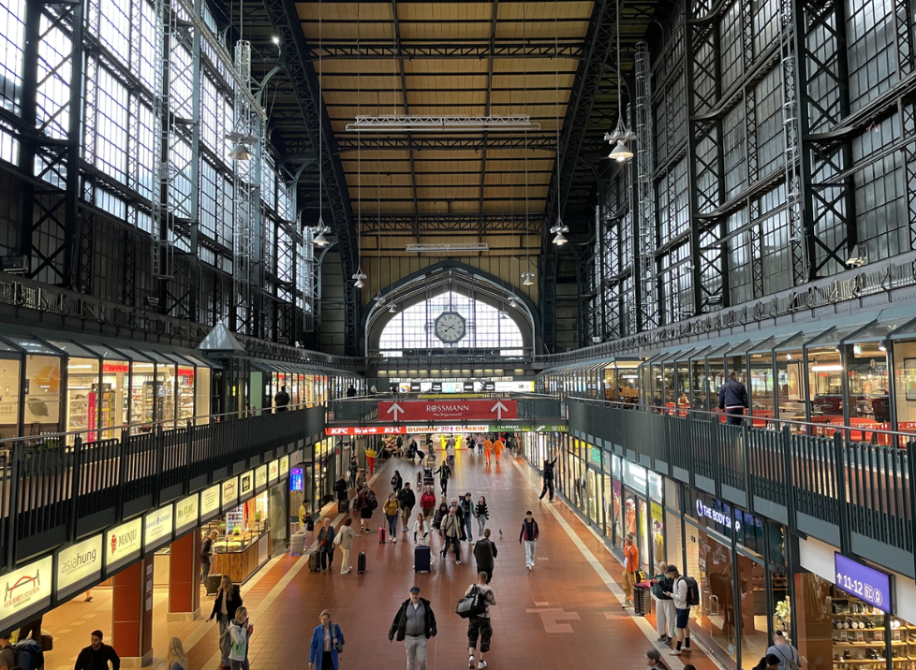
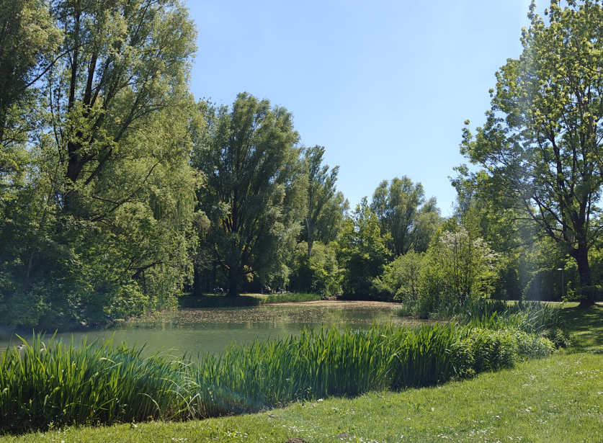
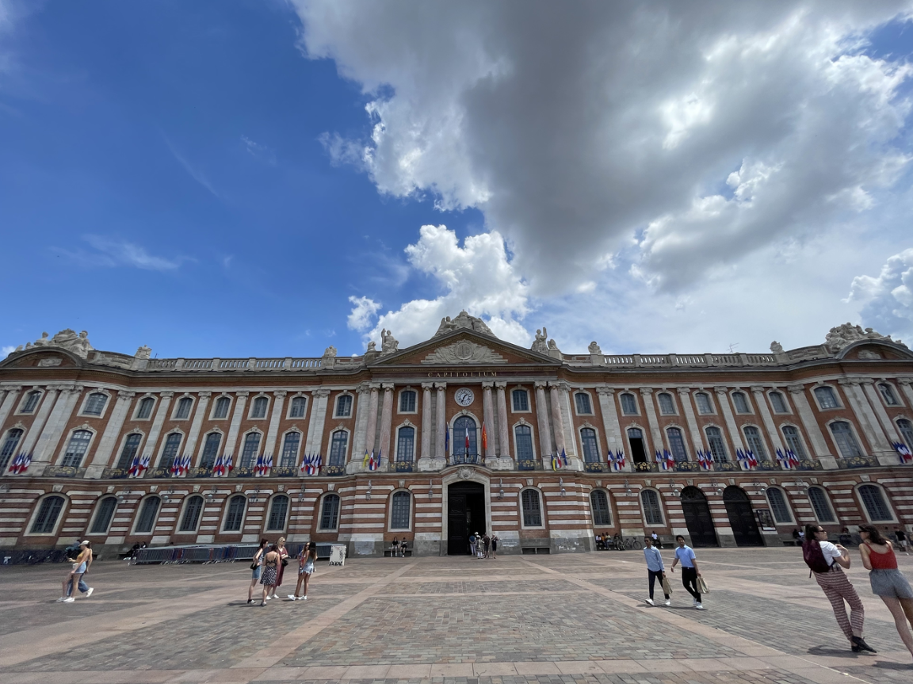
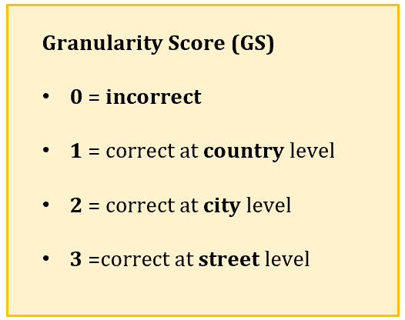
RQ1: Benchmark – Approach
Image Dataset
Existing datasets: street view images -> risk of overfitting, scene limitations [6,7]
86 smartphone images
Balanced locatability [3] (quantifying ease of geo-localization): high (>0.4) and low (<0.4)
Geographic diversity: multiple countries, urban & rural areas
Scene diversity: night, indoors, and natural
Prompt and Reasoning
Prompt model to think step by step: identify clues -> update candidates iteratively -> conclusion
Model’s repsonse: reasoning summary + location conclusion
SoTA LLMs
OpenAI o4-mini Claude Sonnet 4 Gemini 2.5 Pro
Evaluation Metrics
Correctness: Granularity Score (GS)
Efficiency: response time, response token, reasoning token

Slide 8
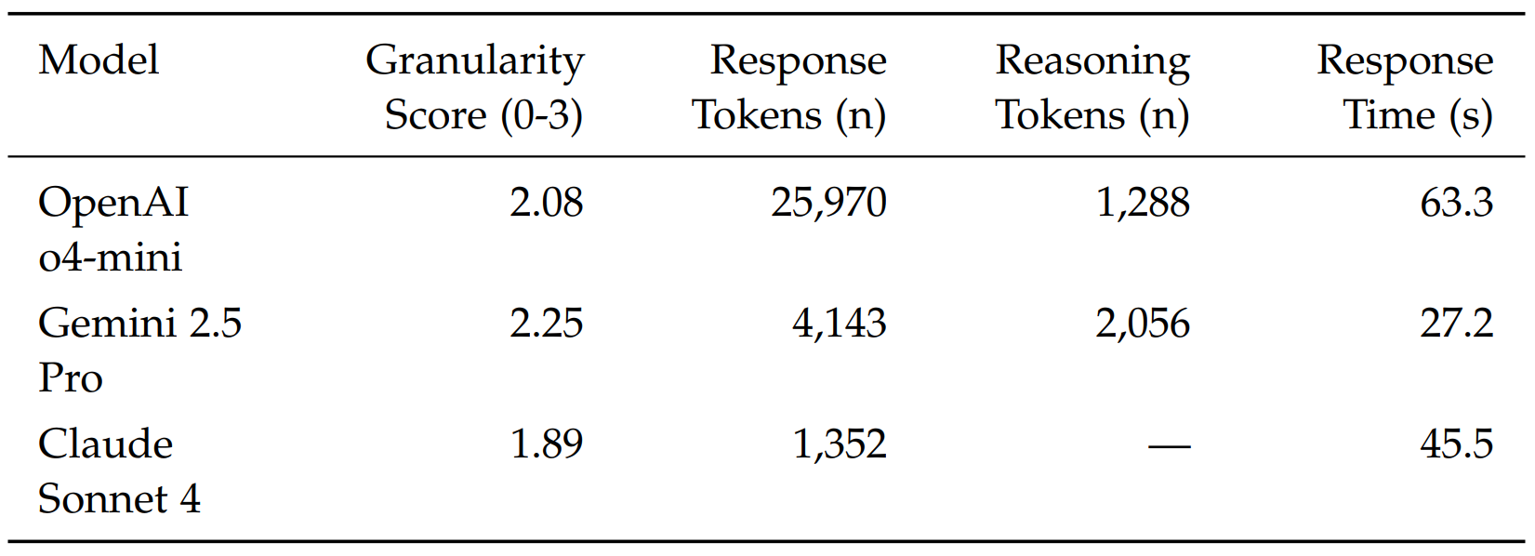
RQ1: Benchmark – Results
All models: ~ city-level correctness (GS ≈ 2.0)
OpenAI o4-mini: medium GS, high token & time cost
Gemini 2.5 Pro: best GS, fast response
Claude Sonnet 4: lowest GS, lightweight with few tokens

Slide 9
RQ1: Benchmark – Results
All models: ~ city-level correctness (GS ≈ 2.0)
OpenAI o4-mini: medium GS, high token & time cost
Gemini 2.5 Pro: best GS, fast response
Claude Sonnet 4: lowest GS, lightweight with few tokens

Slide 10
RQ1: Benchmark – Results
All models: ~ city-level correctness (GS ≈ 2.0)
OpenAI o4-mini: medium GS, high token & time cost
Gemini 2.5 Pro: best GS, fast response
Claude Sonnet 4: lowest GS, lightweight with few tokens

Slide 11
RQ1: Benchmark – Results
All models: ~ city-level correctness (GS ≈ 2.0)
OpenAI o4-mini: medium GS, high token & time cost
Gemini 2.5 Pro: best GS, fast response
Claude Sonnet 4: lowest GS, lightweight with few tokens

Slide 12
RQ1: Benchmark – Summary
Constructed a dataset with 86 filtered smartphone images
Benchmarked 3 models: achieve city-level correctness, behave differently in performance-efficiency trade-off

Slide 13
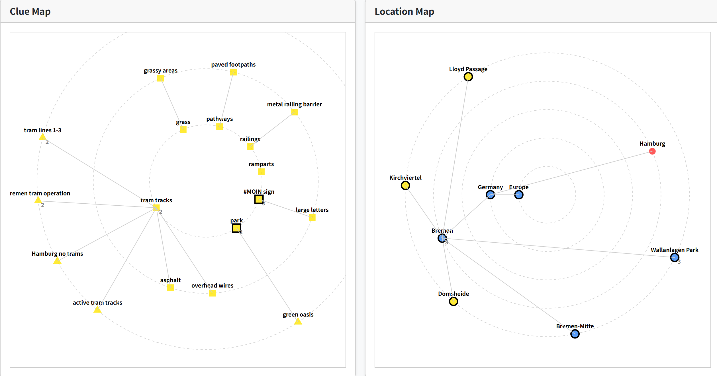
RQ2: Visualization – Introduction
Why do we need visualization?
Reasoning text: long and complex
Hard to follow, little interpretability
Reasoning Summary: I found a search result for the #MOIN sign, which indicates it's located in Wallanlagen, Bremen. The description says the ramparts greet visitors in large letters and that it's a green oasis …
Conclusion: Wallanlagen (Parkanlagen am Wall), Bremen-Mitte, Bremen, Germany, Europe
GeoMindMap

Slide 14
RQ2: Visualization – Approach
Segmentation: text -> reasoning steps
Entity extraction: text -> entities (clues, locations) -> 2 node lists
Parent and granularity assignment: nodes -> 2 tree layouts
Step-wise matching: step-wise info (mentioned nodes, location status, related clues) -> dynamic update
Visualization: clue map + location map + dynamic + user interaction

Slide 15
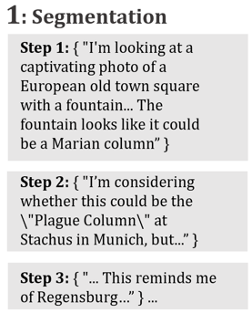
RQ2: Visualization – Approach
Segmentation: text -> reasoning steps
Entity extraction: text -> entities (clues, locations) -> 2 node lists
Parent and granularity assignment: nodes -> 2 tree layouts
Step-wise matching: step-wise info (mentioned nodes, location status, related clues) -> dynamic update
Visualization: clue map + location map + dynamic + user interaction

Slide 16
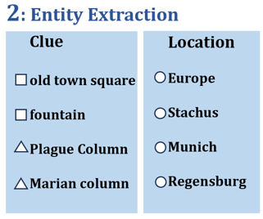
RQ2: Visualization – Approach
Segmentation: text -> reasoning steps
Entity extraction: text -> entities (clues, locations) -> 2 node lists
Parent and granularity assignment: nodes -> 2 tree layouts
Step-wise matching: step-wise info (mentioned nodes, location status, related clues) -> dynamic update
Visualization: clue map + location map + dynamic + user interaction

Slide 17
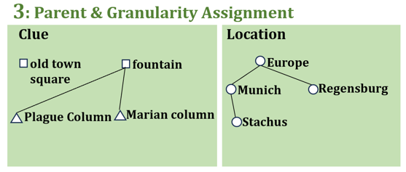
RQ2: Visualization – Approach
Segmentation: text -> reasoning steps
Entity extraction: text -> entities (clues, locations) -> 2 node lists
Parent and granularity assignment: nodes -> 2 tree layouts
Step-wise matching: step-wise info (mentioned nodes, location status, related clues) -> dynamic update
Visualization: clue map + location map + dynamic + user interaction

Slide 18
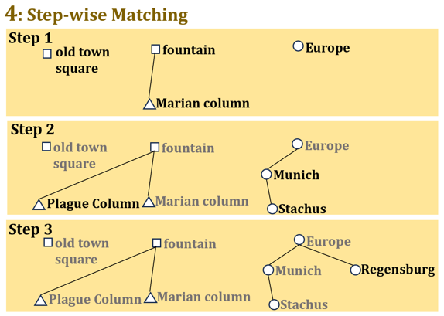
RQ2: Visualization – Approach
Segmentation: text -> reasoning steps
Entity extraction: text -> entities (clues, locations) -> 2 node lists
Parent and granularity assignment: nodes -> 2 tree layouts
Step-wise matching: step-wise info (mentioned nodes, location status, related clues) -> dynamic update
Visualization: clue map + location map + dynamic + user interaction

Slide 19
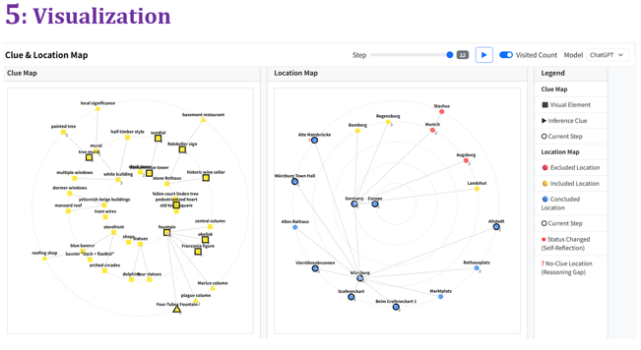
RQ2: Visualization – Approach
Segmentation: text -> reasoning steps
Entity extraction: text -> entities (clues, locations) -> 2 node lists
Parent and granularity assignment: nodes -> 2 tree layouts
Step-wise matching: step-wise info (mentioned nodes, location status, related clues) -> dynamic update
Visualization: clue map + location map + dynamic + user interaction

Slide 20
RQ2: Visualization – Results
Web Demo:
https://wyjxx.github.io/geomindmap/

Slide 21
RQ2: Visualization – Summary
Introduced visualization framework GeoMindMap
Enabled fine-grained and dynamic interpretability

Slide 22
RQ3: Characterization – Introduction
Goal:
Beyond performance and visualization
Identify consistent reasoning features in model trajectories

Slide 23
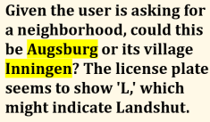
RQ3: Characterization – Approach
Reasoning Gap: mention a location without supporting clues
Self-Reflection: revisit and change location decision status
Breadth-First (BF) Strategy: divergent exploration strategy, list clues and locations broadly
Depth-First (DF) Strategy: convergent verification strategy, focus on specific hypothesis with detailed check
Strategy Switch: transition between BF and DF

Slide 24
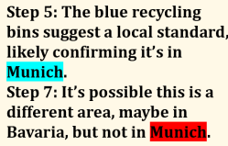
RQ3: Characterization – Approach
Reasoning Gap: mention a location without supporting clues
Self-Reflection: revisit and change location decision status
Breadth-First (BF) Strategy: divergent exploration strategy, list clues and locations broadly
Depth-First (DF) Strategy: convergent verification strategy, focus on specific hypothesis with detailed check
Strategy Switch: transition between BF and DF

Slide 25
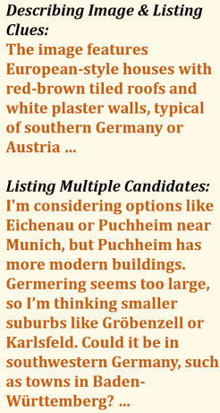
RQ3: Characterization – Approach
Reasoning Gap: mention a location without supporting clues
Self-Reflection: revisit and change location decision status
Breadth-First (BF) Strategy: divergent exploration strategy, list clues and locations broadly
Depth-First (DF) Strategy: convergent verification strategy, focus on specific hypothesis with detailed check
Strategy Switch: transition between BF and DF

Slide 26
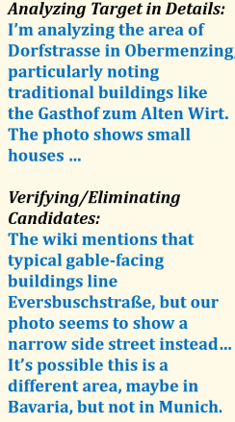
RQ3: Characterization – Approach
Reasoning Gap: mention a location without supporting clues
Self-Reflection: revisit and change location decision status
Breadth-First (BF) Strategy: divergent exploration strategy, list clues and locations broadly
Depth-First (DF) Strategy: convergent verification strategy, focus on specific hypothesis with detailed check
Strategy Switch: transition between BF and DF

Slide 27
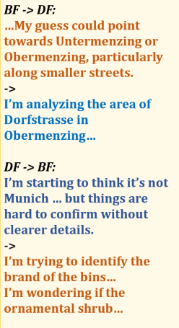
RQ3: Characterization – Approach
Reasoning Gap: mention a location without supporting clues
Self-Reflection: revisit and change location decision status
Breadth-First (BF) Strategy: divergent exploration strategy, list clues and locations broadly
Depth-First (DF) Strategy: convergent verification strategy, focus on specific hypothesis with detailed check
Strategy Switch: transition between BF and DF

Slide 28
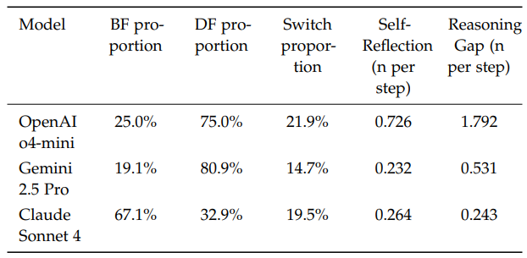
RQ3: Characterization – Results
How frequent?
All five features were consistently observed in all models
OpenAI: focus on Depth-First, unstable
Gemini: focus on Depth-First, stable
Claude: focus on Breadth-First

Slide 29
RQ3: Characterization – Results
How frequent?
All five features were consistently observed in all models
OpenAI: focus on Depth-First, unstable
Gemini: focus on Depth-First, stable
Claude: focus on Breadth-First

Slide 30
RQ3: Characterization – Results
How frequent?
All five features were consistently observed in all models
OpenAI: focus on Depth-First, unstable
Gemini: focus on Depth-First, stable
Claude: focus on Breadth-First

Slide 31
RQ3: Characterization – Results
How frequent?
All five features were consistently observed in all models
OpenAI: focus on Depth-First, unstable
Gemini: focus on Depth-First, stable
Claude: focus on Breadth-First

Slide 32
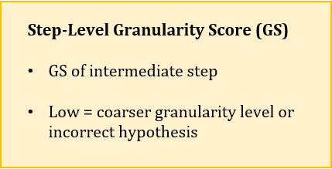
RQ3: Characterization – Results
Indicator for Granularity Score (GS)?

Slide 33
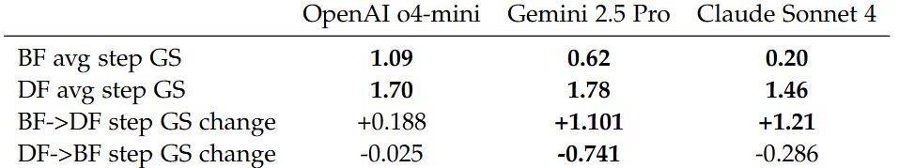
RQ3: Characterization – Results
Indicator for Granularity Score (GS)?
Step-level GS:
DF achieves significant higher step-level GS than BF
Switch to DF generally increases step-level GS

Slide 34
RQ3: Characterization – Results
Indicator for Granularity Score (GS)?
Step-level GS:
DF achieves significant higher step-level GS than BF
Switch to DF generally increases step-level GS

Slide 35
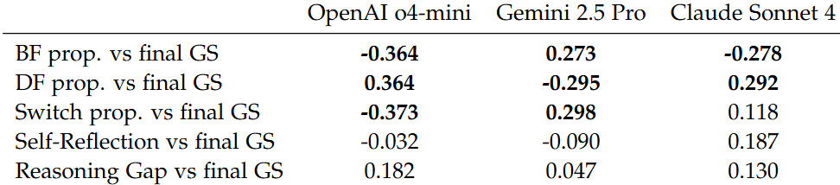
RQ3: Characterization – Results
Indicator for Granularity Score (GS)?
Step-level GS:
DF achieves significant higher step-level GS than BF
Switch to DF generally increases step-level GS
Final GS (correctness):
Self-Reflection & Reasoning Gap: no significant correlation
BF& DF & Switch: model-specific correlation

Slide 36
RQ3: Characterization – Results
Indicator for Granularity Score (GS)?
Step-level GS:
DF achieves significant higher step-level GS than BF
Switch to DF generally increases step-level GS
Final GS (correctness):
Self-Reflection & Reasoning Gap: no significant correlation
BF& DF & Switch: model-specific correlation

Slide 37
RQ3: Characterization – Summary
Identified 5 reasoning features: Reasoning Gap, Self-Reflection, BF, DF, and Switch
Consistently observable; BF, DF, Switch as indicators for GS

Slide 38
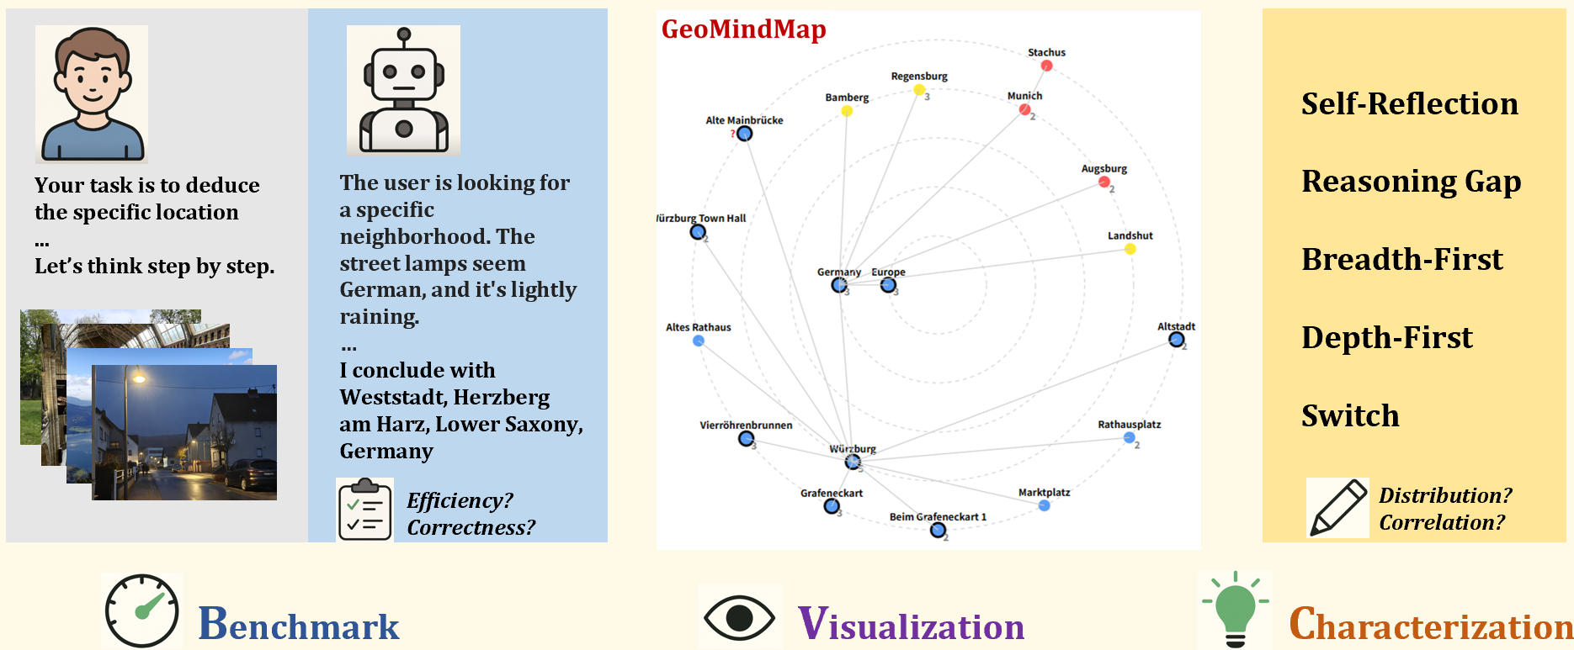
Discussion
Contributions:
Benchmark: helps developers improve performance-efficiency trade-off
Visualization: facilitates the user’s trust in LLM decision-making
Characterization: provides new evaluation metrics + inspires human problem-solving strategies
Limitations:
Limited dataset
Step-level segmentation
LLM-relied processing

Slide 39
Thank you for your attention!
Citations:
[1] Z. Li, E. Shareghi, and N. Collier. ReasonGraph: Visualisation of Reasoning Paths. 2025. arXiv: 2503.03979 [cs.CL].
[2] R. Y. Pang, K. J. K. Feng, S. Feng, C. Li, W. Shi, Y. Tsvetkov, J. Heer, and K. Reinecke. Interactive Reasoning: Visualizing and Controlling Chain-of-Thought Reasoning in Large Language Models. 2025. arXiv: 2506.23678 [cs.HC].
[3] L. Li, Y. Ye, B. Jiang, and W. Zeng. GeoReasoner: Geo-localization with Reasoning in Street Views using a Large Vision-Language Model. 2024. arXiv: 2406.18572 [cs.CV].
[4] Z. Xiong, Y. Cai, Z. Li, and Y. Wang. Mapping the Minds of LLMs: A Graph-Based Analysis of Reasoning LLM. 2025. arXiv: 2505.13890 [cs.CL].
[5] P. Mondorf and B. Plank. Beyond Accuracy: Evaluating the Reasoning Behavior of Large Language Models – A Survey. 2024. arXiv: 2404.01869 [cs.CL].
[6] Z. Song, J. Yang, Y. Huang, J. Tonglet, Z. Zhang, T. Cheng, M. Fang, I. Gurevych, and X. Chen. Geolocation with Real Human Gameplay Data: A Large-Scale Dataset and Human-Like Reasoning Framework. 2025. arXiv: 2502.13759 [cs.CV]
[7] F. Cheng, J. Wang, S. Wang, Z. Huang, and X. Li. GeoGuess: Multimodal Reasoning based on Hierarchy of Visual Information in Street View. 2025. arXiv: 2506.16633 [cs.CL].

